Slide 1
Good to Great Chapter 8 The Flywheel and the Doom Loop
Revolution means turning the wheel

Slide 2
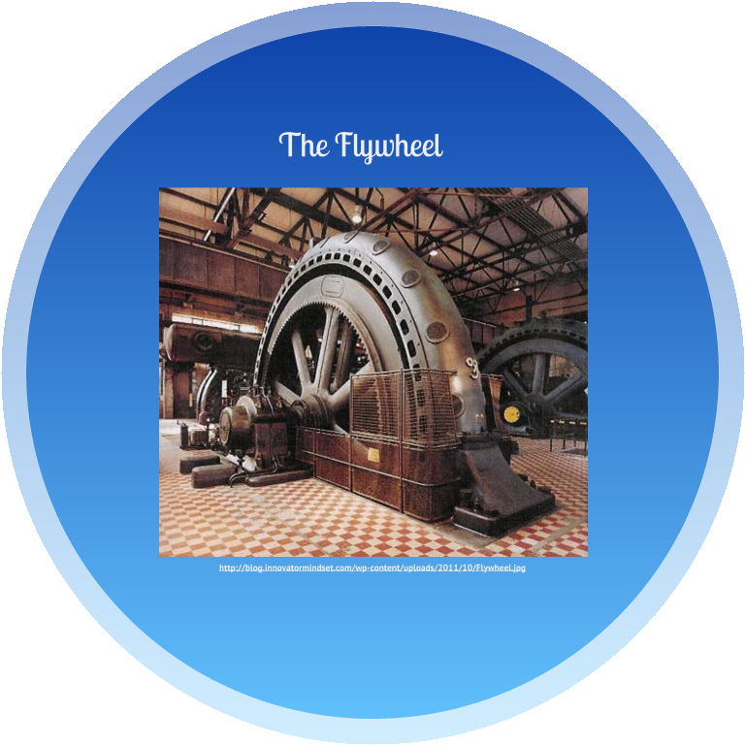
Slow but sure, the constant application of focused effort causes the flywheel to spin faster and faster. Each turn of the flywheel builds upon work done earlier, compounding your investment of effort.

Slide 3
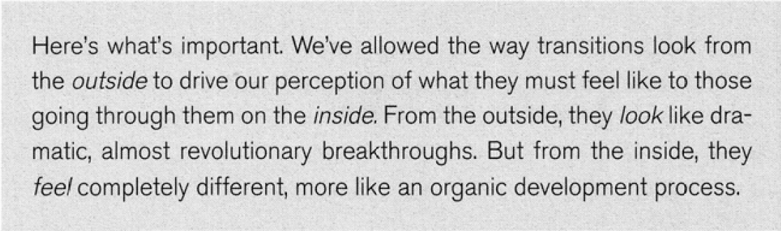
Media Misconceptions

Slide 4
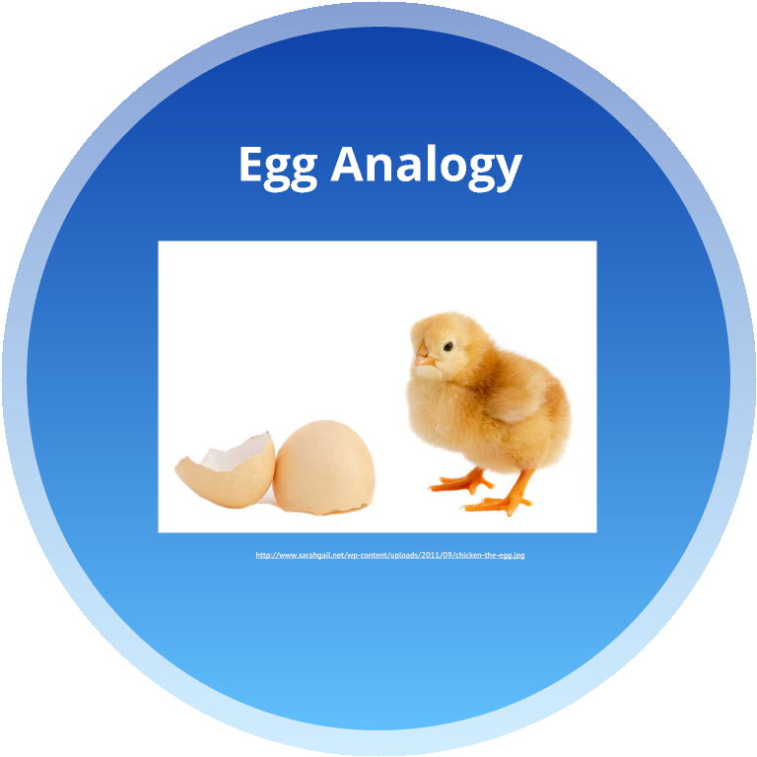
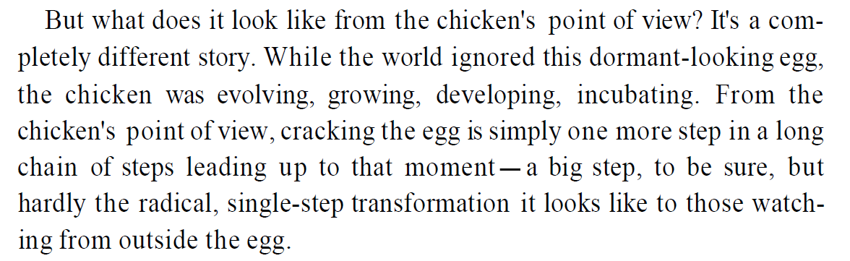
The Egg Analogy

Slide 5
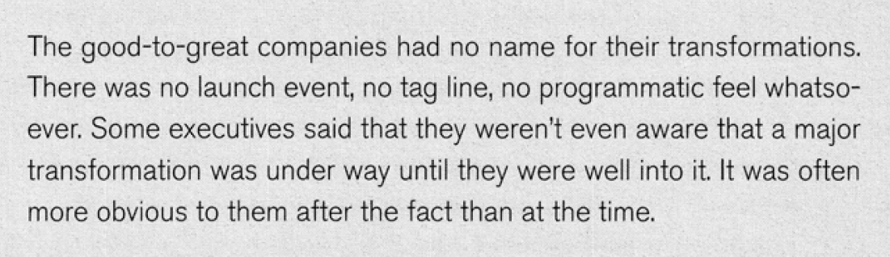
Transformations

Slide 6
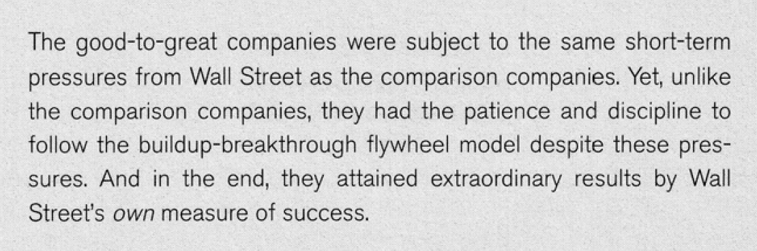
Manage Short Term Pressures

Slide 7
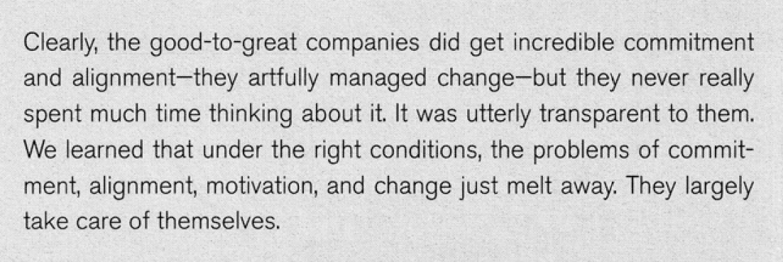
Commitment, Alignment, and How They Managed Change

Slide 8
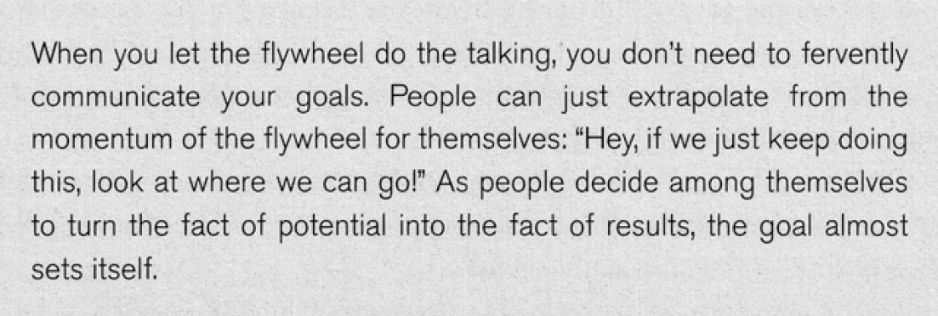
Let the Flywheel do the Talking

Slide 9
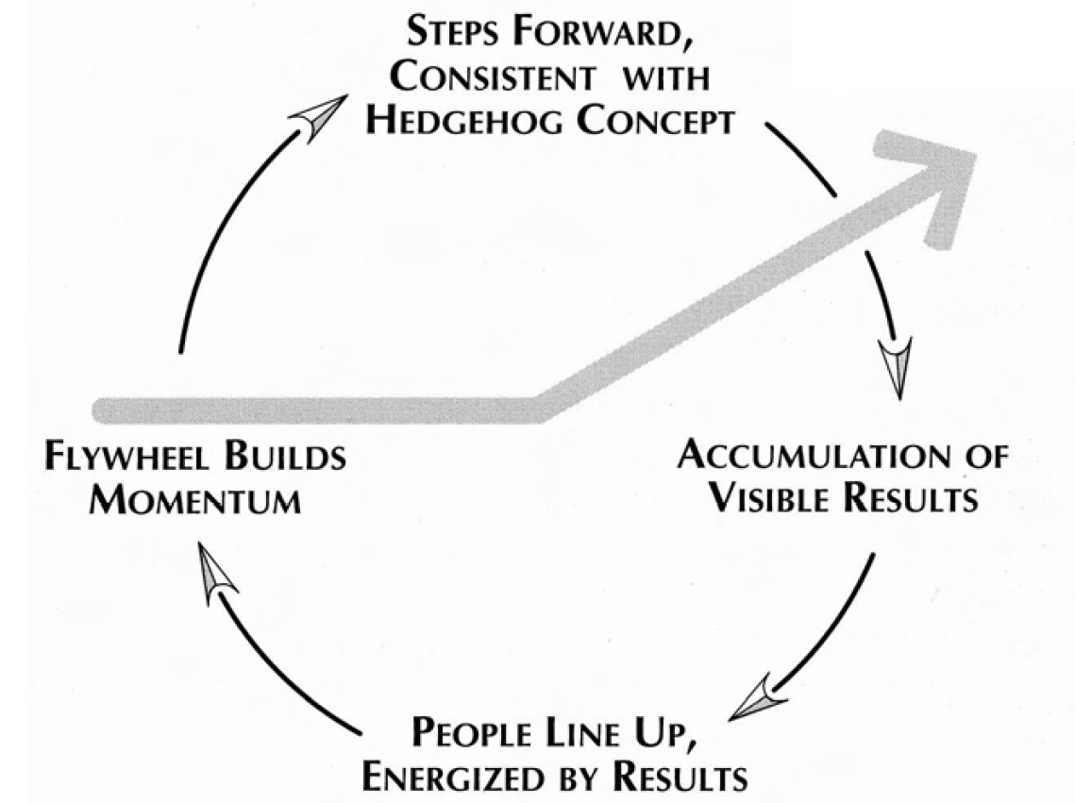
The Flywheel Effect - Summary

Slide 10
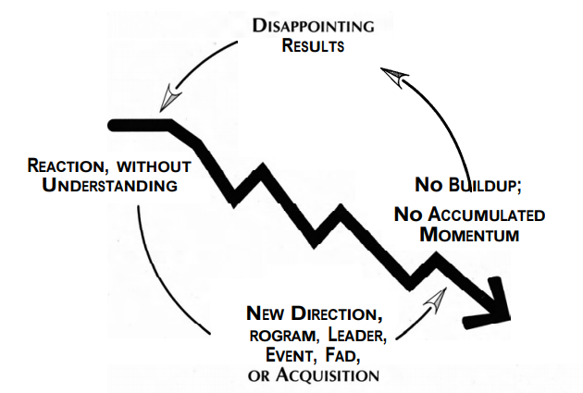
The DOOM LOOP

Slide 11
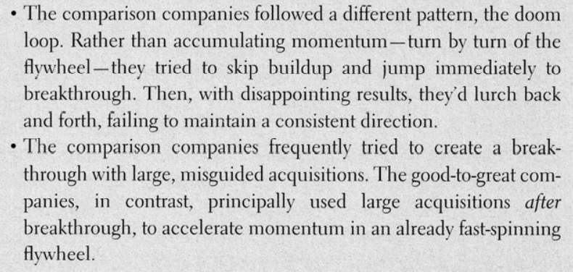
The Comparison Companies

Slide 12
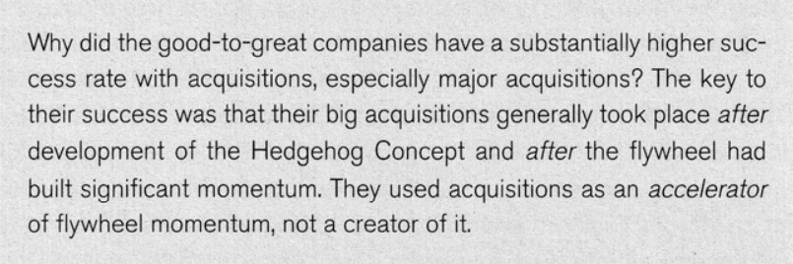
Acquisitions Two Big Mediocrities Joined Together Never Make One Great Company

Slide 13
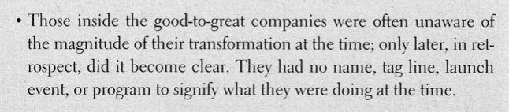
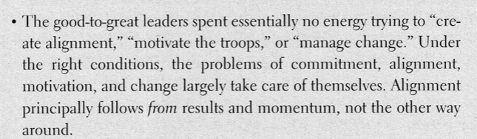
Unexpected Findings

